Slide 1
Healthy Milk Collecting System
E/17/012 AMARASINGHE R.A.A.U.
E/17/038 CHANDRASEKARA C.M.A.
E/17/101 GUNATHILAKA S.P.A.U.

Slide 2
01
Overview
Agenda
02
Solution Architecture
03
Hardware Solution
04
Front End Designs
05
Testing
06
Technologies
07
Features & Budget

Slide 3
Overview

Slide 4

Milk Quality Tester
Detects Milk Adulterants
Portable
Not Having a proper method of testing when buying milk from farmers
Common milk adulterants (Water,Urea)
Easy Usage
Low Power Consumption

Slide 5



Expected Outcomes
Collector / Buyer
Farmer / Seller
Reducing wastage
Get rid of traditional methods
Reducing need of high level laboratory testing
Easy to expand production level
Ability to get higher value & demand for good milk
A smart way to access financial records

Slide 6
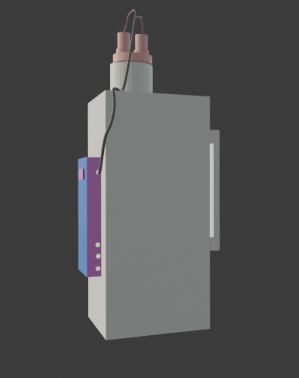
Solution Architecture

Slide 7


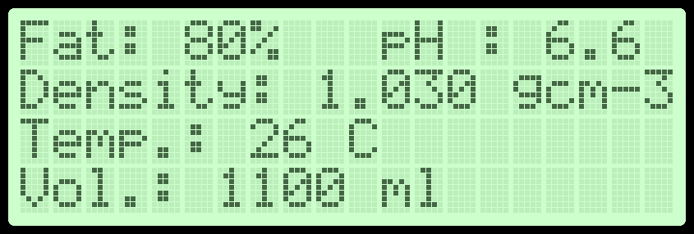
Structure of the system
Sensors
Main unit
pH
Collector’s mobile
ATmega328p
Bluetooth module
Temp.
web/mobile apps
Display
LDR
Control signal unit
Ultrasonic
Load cell
power supply
Buzzer
Control signal unit
min max power

Slide 8
power on
Ultrasonic sensor
Load cell reading
LDR reading
pH sensor
Temp. Sensor
Milk volume calculation
Calibration
Fat rate
Density calculation
Corrected density
Display

Slide 9
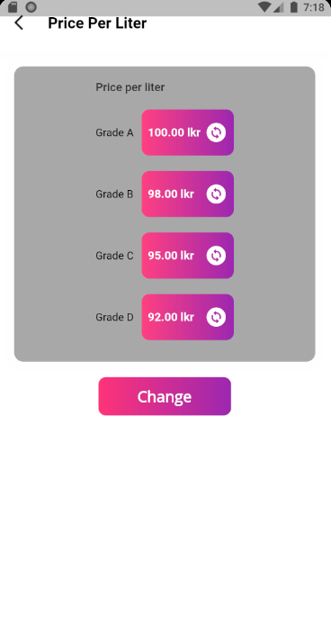
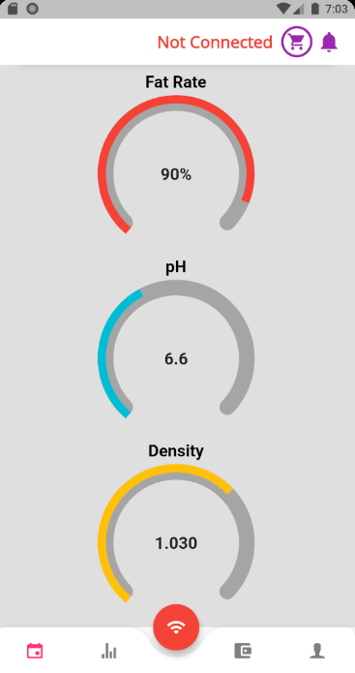
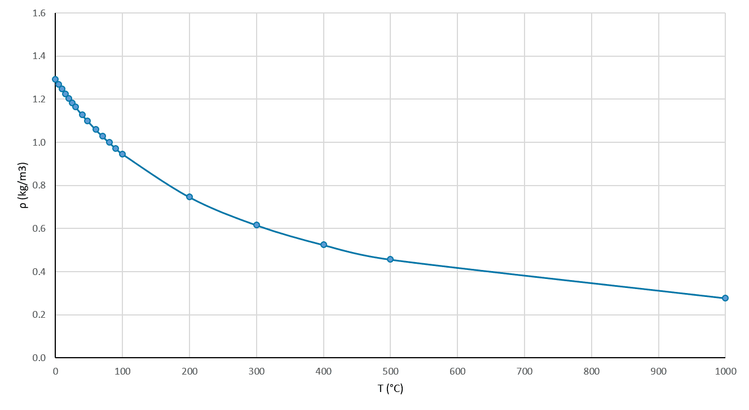
Grading
Considering the deviation of Quality parameters
Density
water
A
B
C
D

Slide 10
ER Diagram
Email
Type
Fname
Lname
Collctor_id
DEALS_WITH
Name
Email
1
COLLECTOR
M
N
Phone
USES
1
Phone
Name
Pwd
FARMER
Pwd
DEVICE
Fname
Lname
1
Farmer_id
Deice_id
1
ADDS
UPLOADS
N
1
N
VIEWS
1
SUPPLIES
N
Grade
DateTime
N
Totalvolume
pH
Subrecord_id
Pricerate
Record_id
N
1
SUBRECORD
HAS
DAILYRECORD
AvgDensity
Temp
Volume
Fat-rate
Density
AvgpH
AvgTemp
Avgfat-rate
DateTime

Slide 11
Hardware Solution

Slide 12
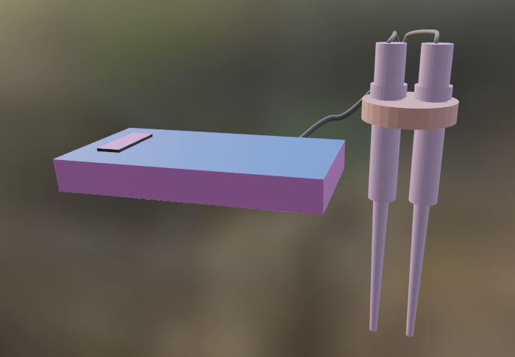
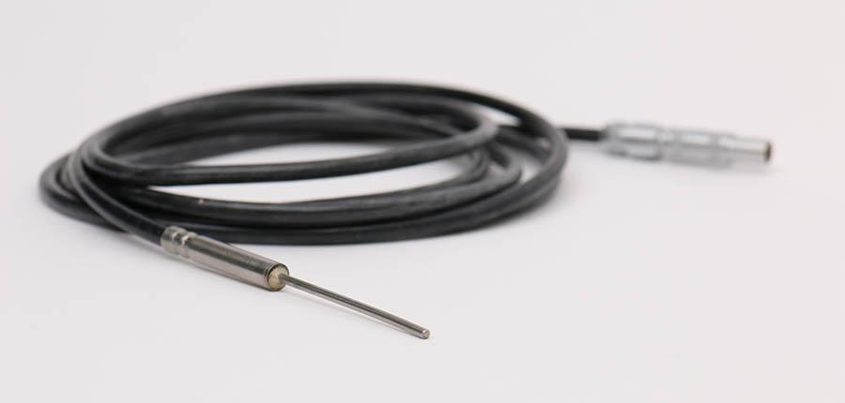
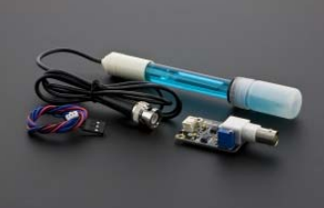
DS18B20 Temperature Sensor
Accuracy: ±0.5°C
Range: -10 to +85 celsius
Programmable
PH sensor
Accuracy: ± 0.1pH
Response Time: < 1min

Slide 13
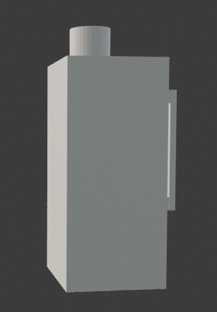
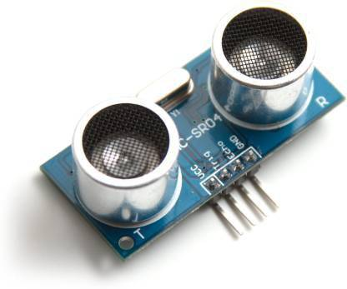
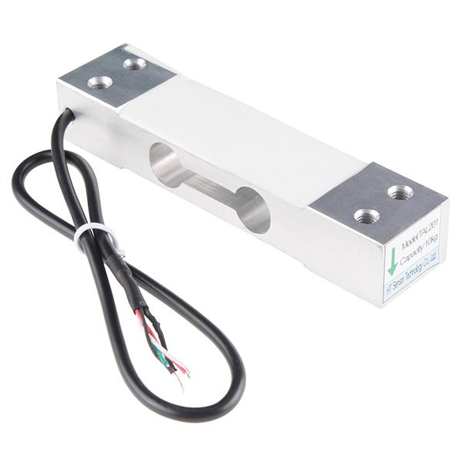
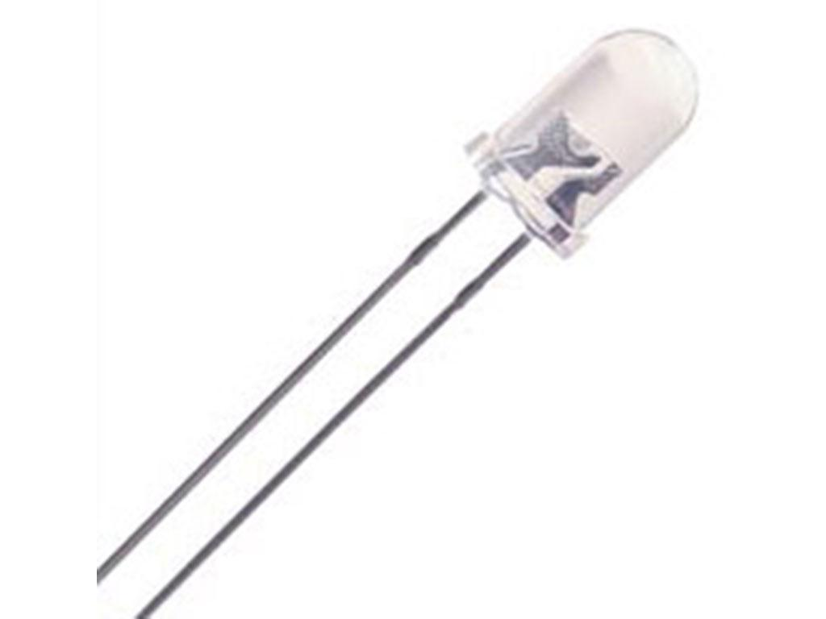
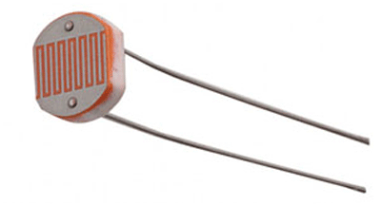
Ultrasonic Distance sensor
Range : 2 cm - 4 m
Accuracy: upto 3 mm
Load cell
LED & LDR
Range : 0-5 kg
Precision: 0.05%

Slide 14
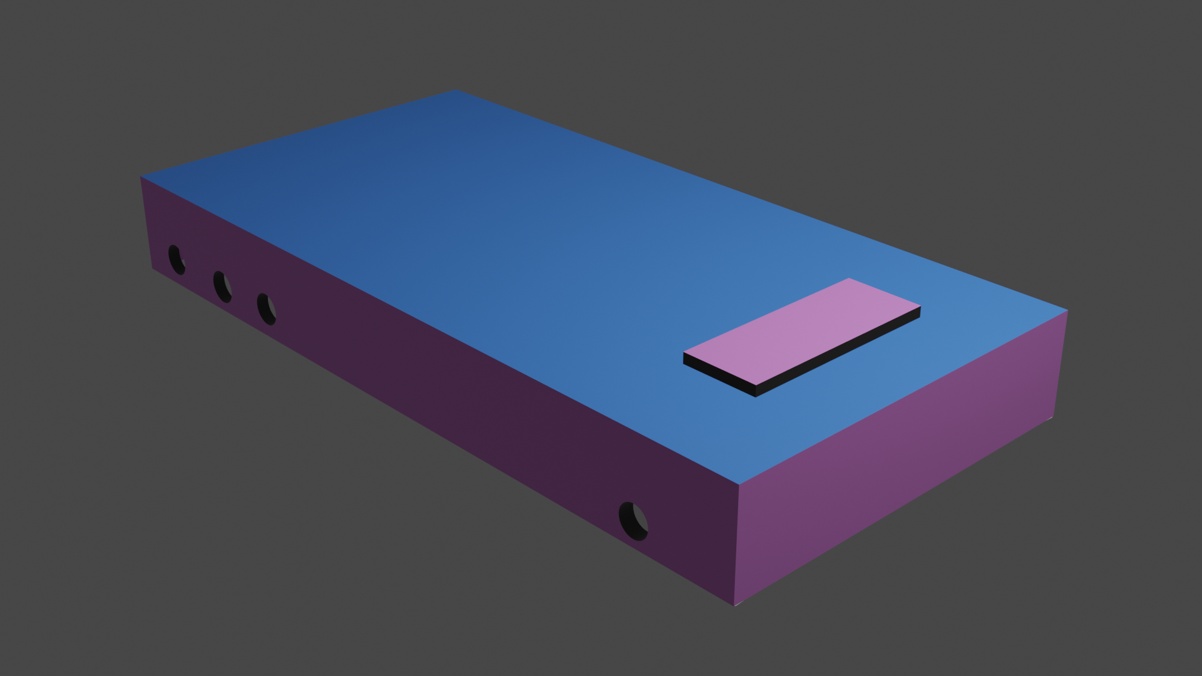
Bluetooth module
Control signals
Buzzer, LEDs
ATmega328p
LCD display 20x4
Power supply
7V power supply

Slide 15
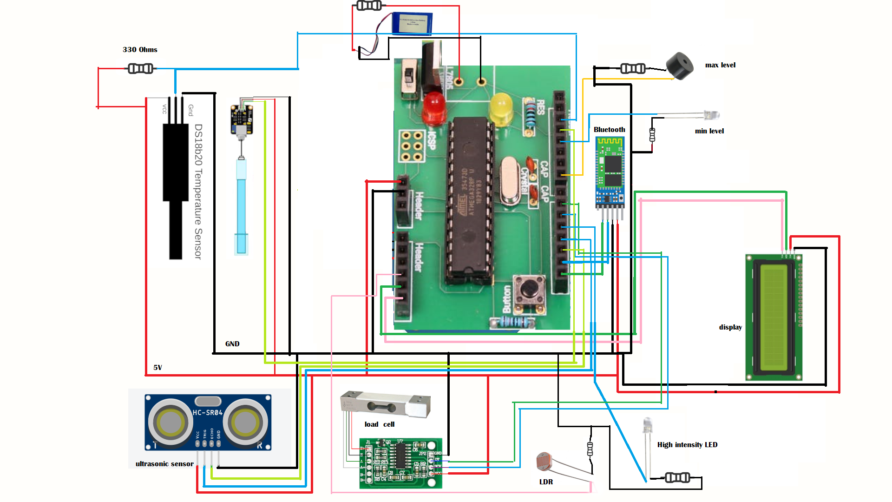
Circuit Diagram

Slide 16
Front End Designs

Slide 17
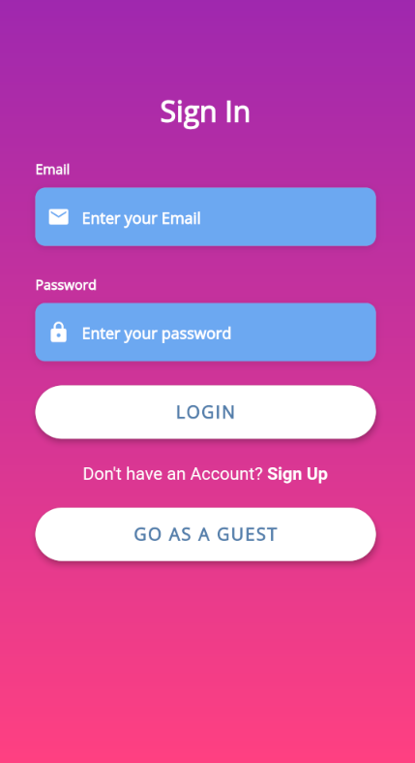
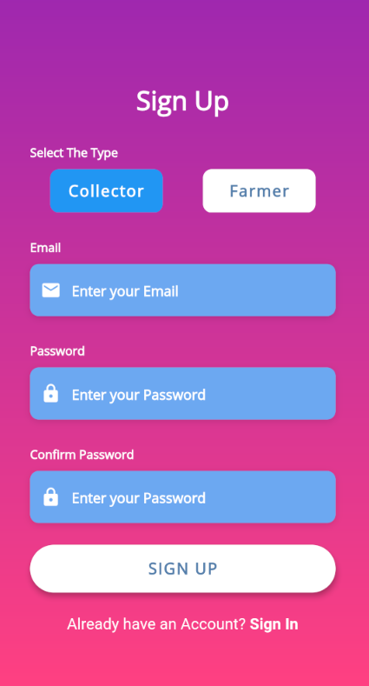
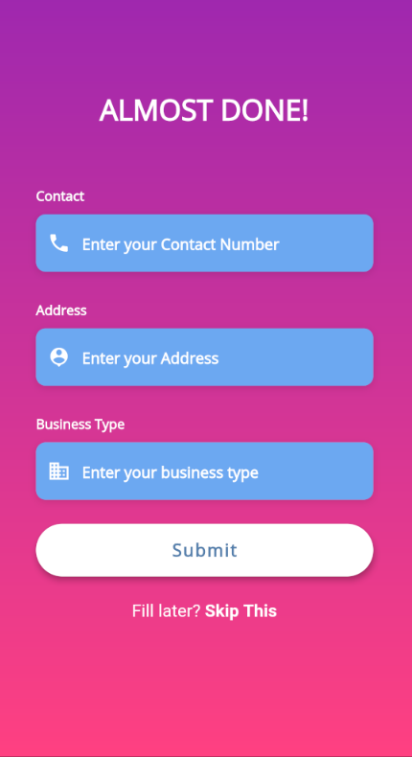

Slide 18
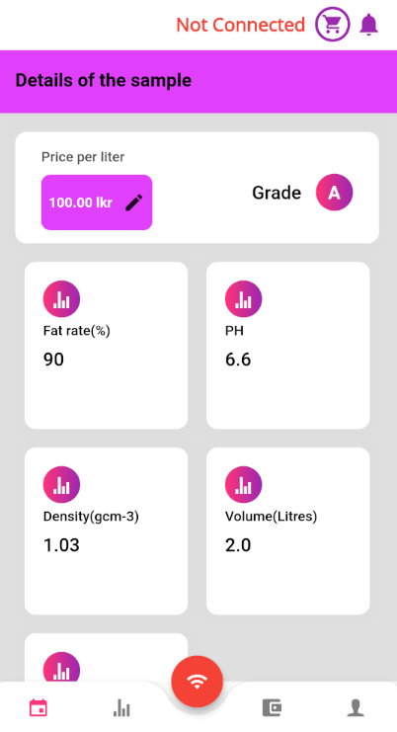
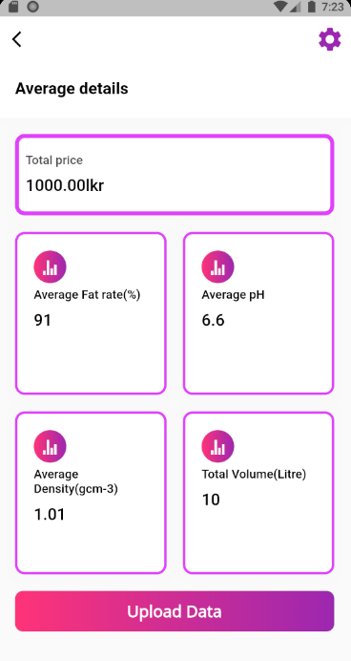

Slide 19
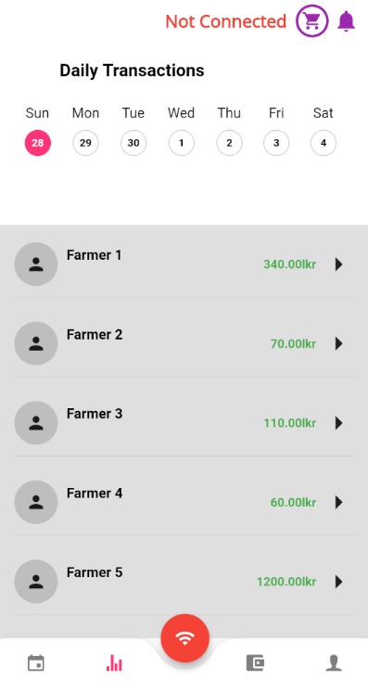
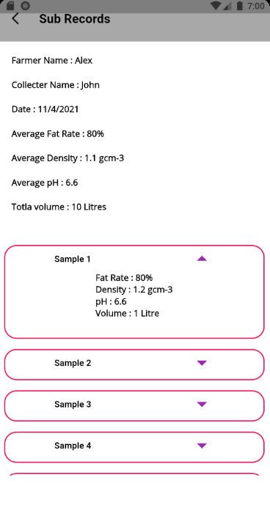
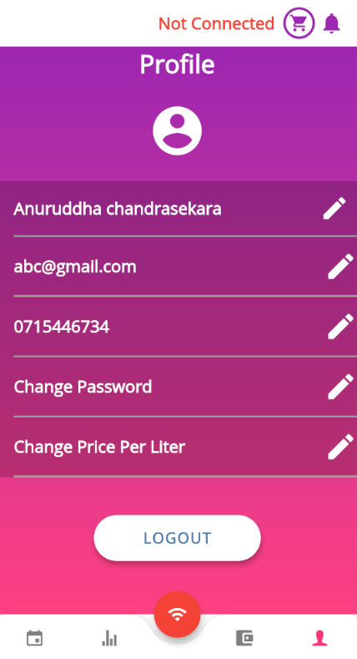

Slide 20
Testing

Slide 21


Testing
Manual Testing
Automated Testing
Testing sensors
Testing milk samples with common milk adulterants
adding water , urea for analyzing
Authentication & Authorization
Accurate processing, communication of data
Proper connection throughout the system
mostly to test calculation results
Authentication
Performance

Slide 22
Unit Testing
pH measurement
fat-rate
temperature
Density
Data communication
Control signal
Integration Testing
End to End Testing
Grade determination
database functionalities

Slide 23
Technologies

Slide 24





Can use across different platforms (Android / IOS/ Web)
Better UI designs
Fully-managed infrastructure
Flexible schema management
MVC Architecture Support
Better efficiency in database handling
Github
POSTMAN
Managing all works in one platform
For testing backend functionalities
Ability test all types of testing

Slide 25
Features & Budget

Slide 26

Security
Reliability
Efficiency
App notifications
transparency of deals
User authentication & authorization
Privacy protection in records
Suitable control signals
Less response time
Autonomous readings
User friendly interfaces

Slide 27
Budget
item | quantity | price(LKR) | item | quantity | price(LKR)
ATmega328p | 1 | 350 | Bluetooth module | 1 | 850
Load cell | 1 | 700 | 20x4 LCD display | 1 | 900
HX711 converter | 1 | 200 | Resistors | 10 | 100
PH sensor | 1 | 3800 | power supply | 1 | 1000
DS18B20 | 1 | 400 | Piezo buzzer | 1 | 100
Ultrasonic sensor | 1 | 300 | Wires & others |  | 400
LDR | 1 | 20 | Cost for model | 1 | 2000
LED | 5 | 100 |  | Total cost | 11220

Slide 28
Q & A

Slide 29
THANK YOU

